Slide 1
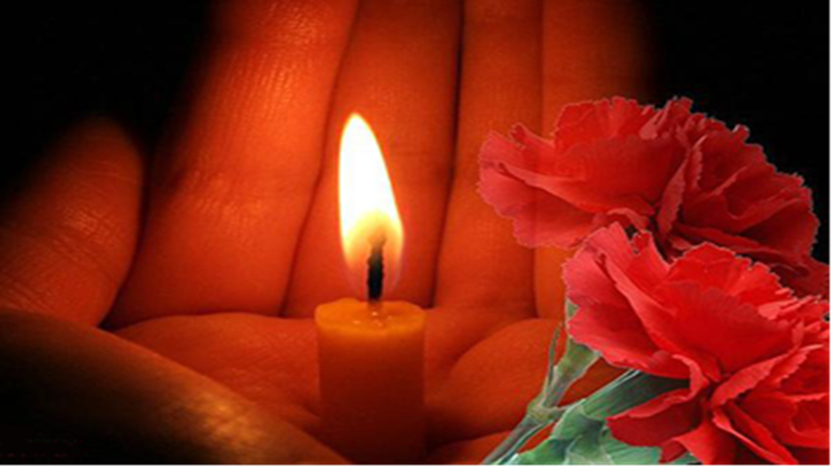
We remember……We are proud……
passing the memory candle………
Чинь Бао Тханг
Класс: 10”А”
Школа №5

Slide 2
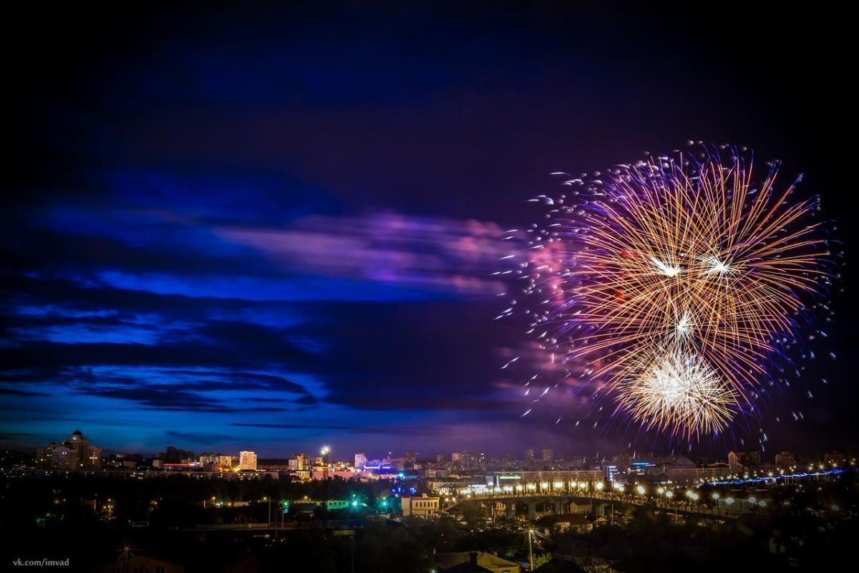
The town of the first Salute

Slide 3
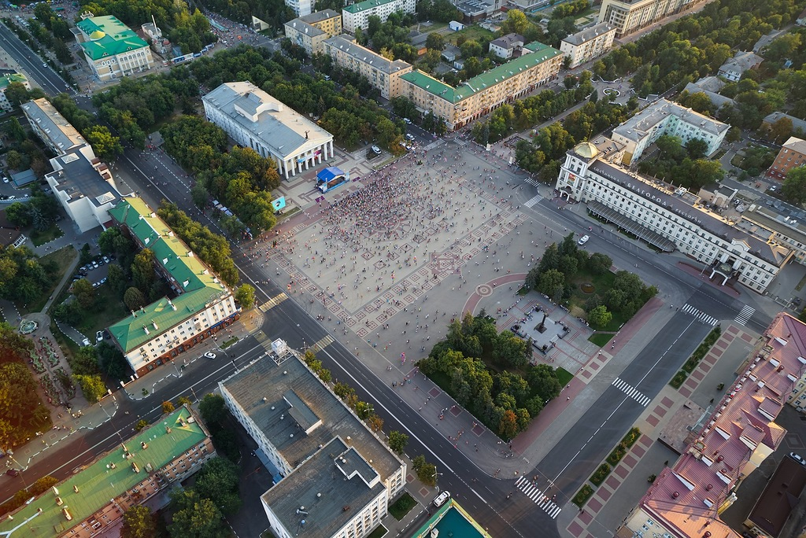
This town is situated in the South of black earth Zone It is called Belgorod. The white chalk hills give the name of the town. It is bounded by Ukraine.

Slide 4
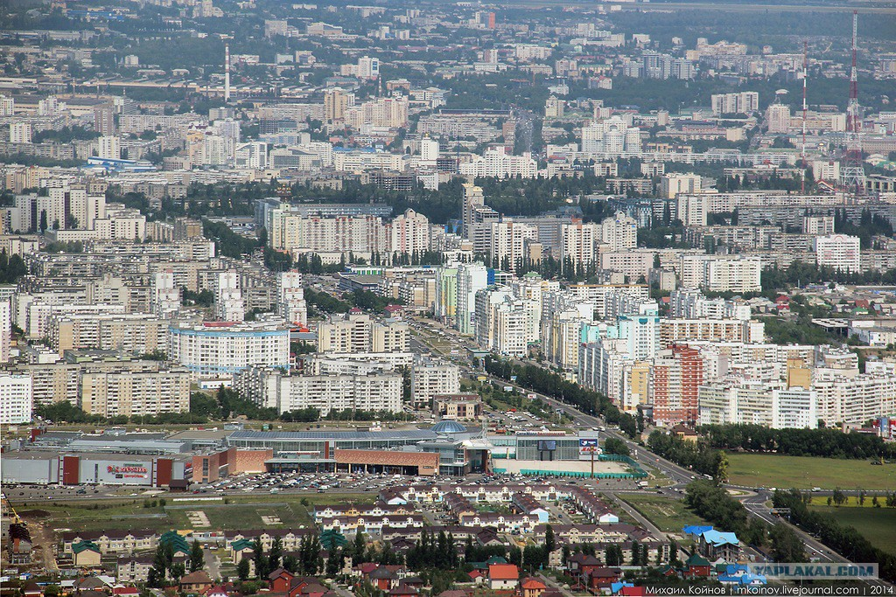
Belgorod first WAS mentioned in the history in 1237. Many times the town was destroyed. But it became stronger from year to year.

Slide 5
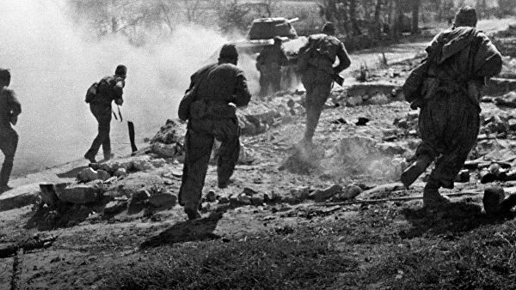
In 1941 the great Patriotic War began, fascist came twice to occupy Belgorod in the course of three year.

Slide 6
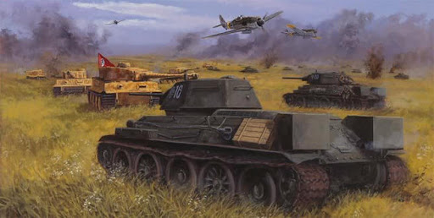
In summer of 1943 a great battle was found at Prokhorovka, thousands of tanks and airplanes took part in it. The future cosmonaut G. T. Beregovoy was among the Soviet pilots defending Prokhorovka in the sky. At Prokhorovka the fascists lost 400 tanks and over 10 000 soldiers and officers.

Slide 7
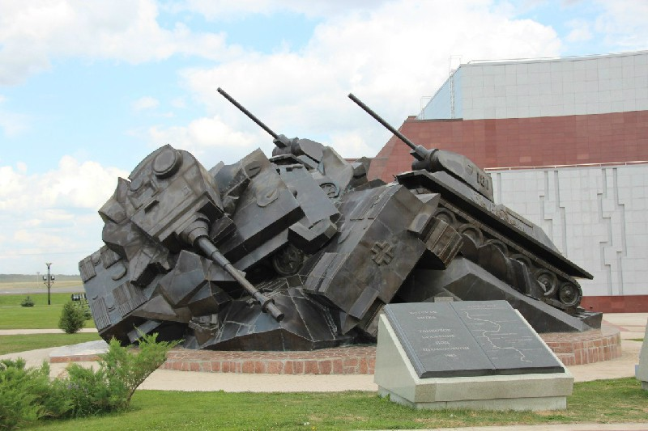
The victory in the battle of Kursk had a great importance as it completed a turning point (after the Stalingrad battle) in the Great Patriotic War.

Slide 8
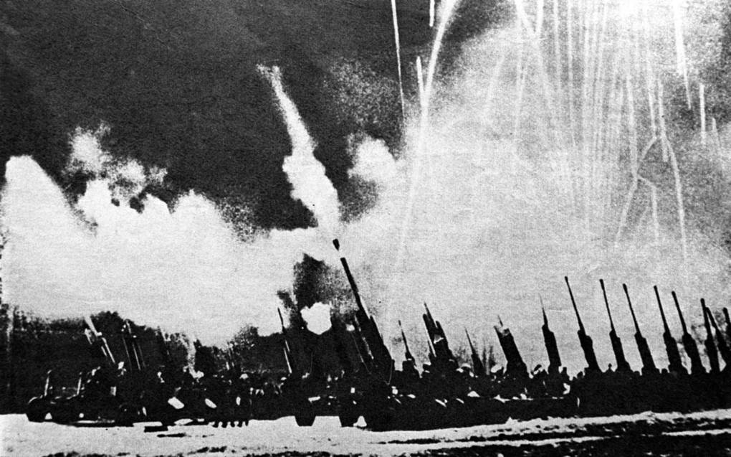
On August 5 1943 Moscow fired a salute in honor of the liberation of Belgorod and Oryol from the Nazi invaders for the first time during the war years.

Slide 9
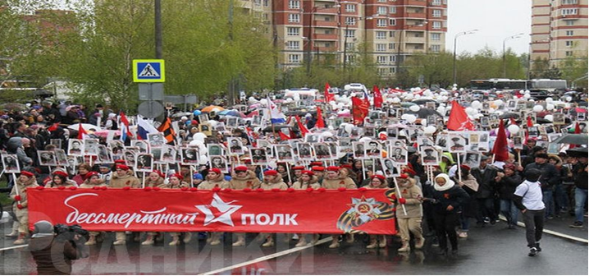
The Immortal Regiment: the pride and memory of Russia

